Slide 1
Dungeon of the Mighty Titan - Vanquish
Final Presentation
David Bond, Matthew Yengle, Timothy Canipe, Vishal Bhatt

Slide 2
Table of Contents
Approach and Focus
Requirements and Timeline
System Model
Sub-Modules and Subsystems
Demonstration
Future Efforts

Slide 3
Initial Approach
Problem
Popular MMOs have a mechanic that allows players to form groups and raid dungeons filled with powerful monsters and rare items. However, in these popular games, players need to play for hours and hours, obtaining better items and higher levels, before they can experience this mechanic.
Solution
In our game, players will be able to fight through dungeons with a group of friends from the very beginning.
Notes:
@Matt

Slide 4
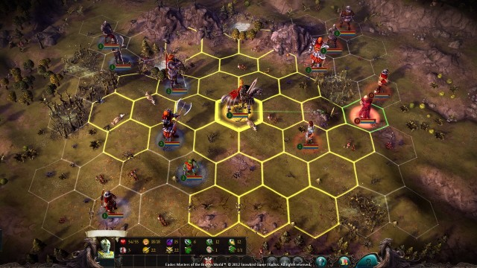
Focus
Gameplay-driven over storyline.
Multiplayer over singleplayer.
Turn-based combat system over real-time.
Platform
Desktop, Windows OS (7 and newer)
Genre
RPG, Multiplayer, Turn-Based Strategy, Roguelike, Dungeon Crawler, Isometric
Eador: Masters of the Broken World. (2013). Snowbird Games.
Notes:
@Matt

Slide 5
Unreal Engine 4
Advanced Turn Based Tile Toolkit (ATBTT)
A development kit used to create games, usually called a game engine [1].
Developed by Epic Games, Inc.
Framework for developers to create turn based games with the Unreal Engine [2].
Developed by Knut Overbye.

Slide 6
Requirements Specification
(COMPLETED) A turn-based movement and combat system.
(COMPLETED) Allow the player to interact with aspects of the game.
(COMPLETED) Be able to run on desktop computers running Windows 7 or newer.
(COMPLETED) Feature an attribute system.
(PENDING) Give playable character classes unique skills that distinguish them from other character classes.
(PENDING) A combat system that gives the player options depending on their class.
(COMPLETED) Use the Steam SDK package to allow Steam users to join game sessions.
(COMPLETED) Have an inventory system with an item database.
(COMPLETED) Be represented using a visual method of design (GUI) that the player will be able to view and interact with.
(PENDING) Include multiplayer functionality.
(NO PROGRESS) Save the state of the game.
(NO PROGRESS) Allow a user to load the saved game.
Notes:
@All

Slide 7
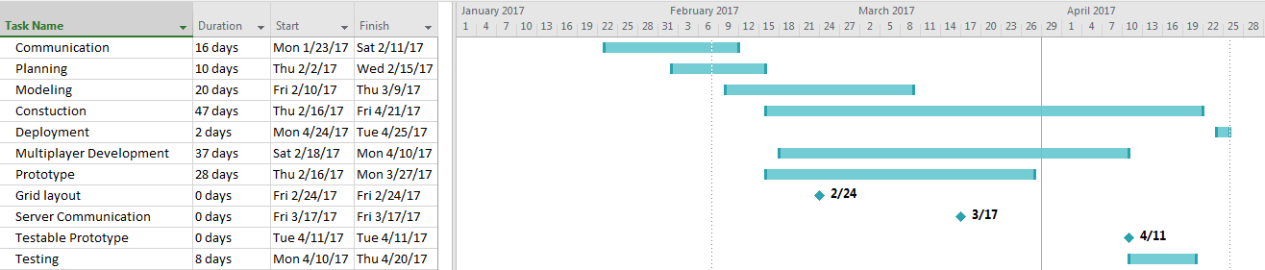
Timeline

Slide 8
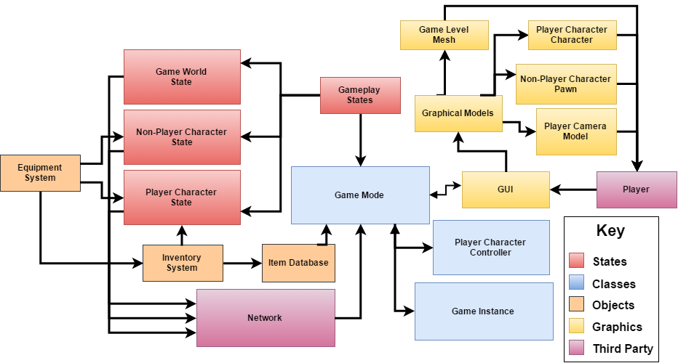
System Model

Slide 9
Sub-Modules
David Bond:
Implementing multiplayer functionalities, which span several components.
Programming of the following game menus: Main menu, Lobby menu, and character selection menu.
Research into the networking aspect of the Unreal Engine.
Coding of the Save and Load systems.
Matthew Yengle:
Coding of the in-game GUIs, as well as additions to the Player Character and Game Mode classes for support.
Creating a database to hold information for the game’s items.
Research into open-source weapon and armor models.
Notes:
@David and Matthew

Slide 10
Sub-Modules cont’d.
Timothy Canipe:
Coding of the Character, Player Character, and Non-Player Character subsystems.
Coding of the Skills and Attributes minor subsystems.
Research into open-source character models, animations, and assets.
Vishal Bhatt:
Coding of the Game World and Game Level major subsystems.
Research into open-source world meshes, level designs, and audio assets.
Notes:
@Timothy and Vishal

Slide 11
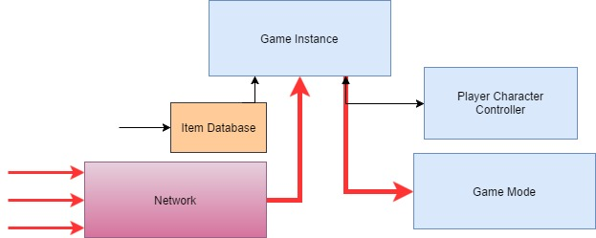
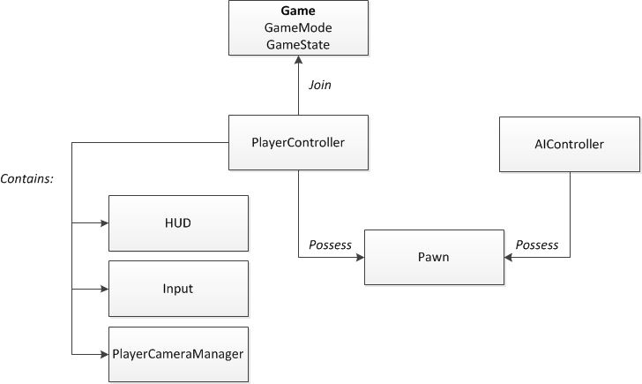
Multiplayer & Gamestate
Client\Server model
Host player is both a client and server
GameMode exists only on the server, the GameState exists on the server and is replicated to all clients[3].
GameState tracks properties that change during gameplay and are relevant and visible to everyone[3].
Clients send updated information to Server, which will propagate updates to all other clients
Unreal Engine will handle LAN connections, while Steam will coordinate WAN connections
Notes:
@David

Slide 12
Client \ Server Model
Unreal Engine handles LAN connections (bypasses Steam)
Steam is used for multiplayer over WAN
Notes:
@David

Slide 13
Characters & skills
There are three main character classes
Knight - High defense/health, but not very fast
Huntress - Fast & long range, but not much health
Mage - high damage, but has little else
Each character has three base skills
Knight - Taunt, Guard, Strike
Huntress - Beastmaster, Critical Strike, Camouflage
Mage - Fireball, Icicle, Lightningbolt
Notes:
@Timothy

Slide 14
Item Database
Each character has 5 or 6 weapons and 1 set of armor.
Items are categorized into tiers based on a quality attribute, ranging from 0 (poor) to 5 (superb).
Three ways to obtain items:
Treasure chests, dead enemies (graves), and vendors.
Equipment system allows for one-handed, dual one-handed, and two-handed weapons to be used.
Ranged and melee class-restricted weapons give the characters different combat strategies.
Notes:
@Matt

Slide 15
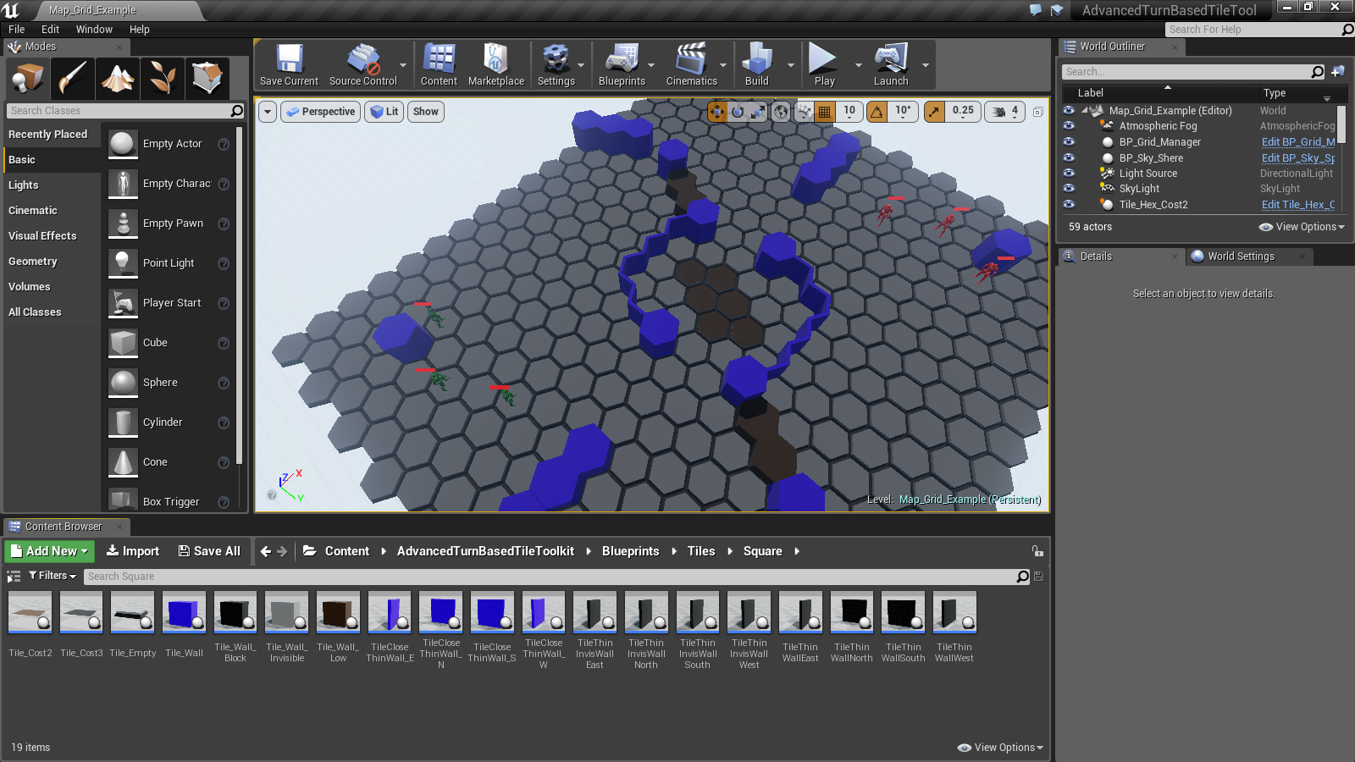
What is Unreal Engine?
A platform that enables people with a vision to implement their ideas.
Supports: All video game consoles, All computer os’s, All Mobile, and even VR

Slide 16
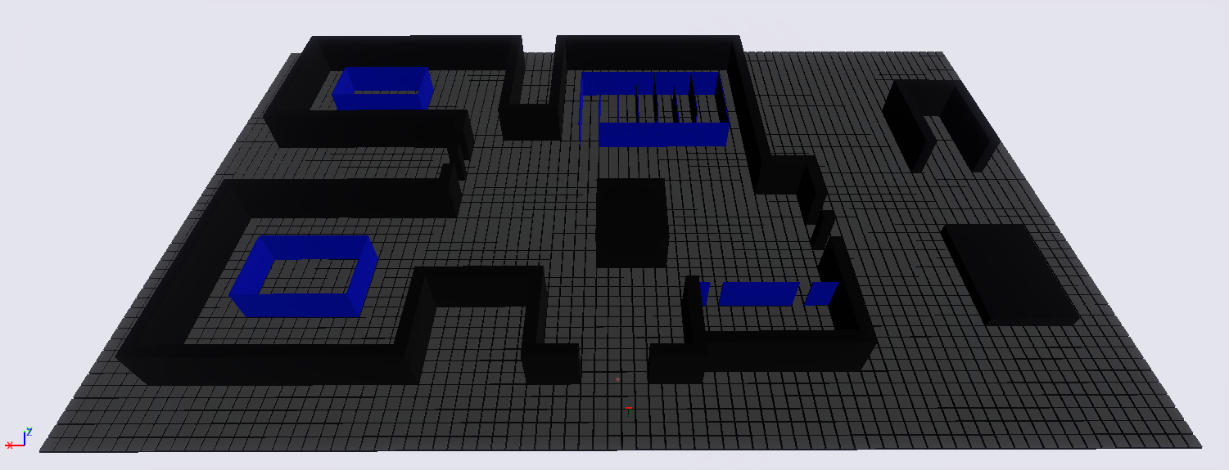
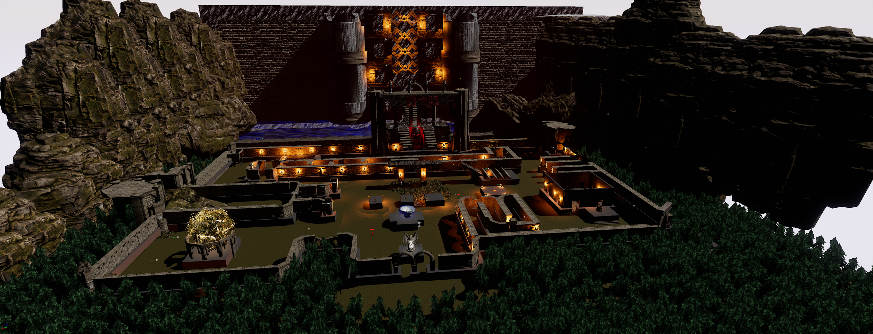
Prototype
Finished Product

Slide 17
Town Map Construction, Music Development, and Website
Advanced Turn Based Tool Kit[1]
Offered turn based algorithm between player and A.I
Infinity Blade Assets [4]
Assets acquired through Unreal Engine 4 Marketplace to expedite the town map.
Fruity Loops Studio (FL Studio)[5]
Created a soothing background.
Github Website
Created a simple website that allows anybody to download and play DMT-V with a ReadMe
Notes:
@Vishal

Slide 18
Demonstration
Notes:
@All

Slide 19
Future Efforts
Multiplayer
Ability to save game data and load game data
Bug testing and general feedback from playtesters.
Notes:
@David

Slide 20
Hypothetical Deployment
Steam Greenlight - Used by “indie” developers to distribute their games.
$100 submission fee for first time development teams [6].
Payment to Epic Games (creators of the UE) and Valve (owners of Steam) are required only for commercial products.
Both companies take a percentage of the total sales (Epic Games - 5%; Valve - negotiated) [6][7].
For all other assets, we have either acquired the license to use it in a free or commercial product, or it is copyright free given that the author is properly credited.
Notes:
@Timothy

Slide 21
Resources
[1] Epic Games, Inc. (n.d.). Unreal Engine. [Online]. Available: https://www.unrealengine.com/what-is-unreal-engine-4
[2] Knut Overbye. (2015, Feb 17). Advanced Turn Based Tile Toolkit. [Online]. Available: https://www.unrealengine.com/marketplace/advanced-turn-based-tile-toolkit
[3] Epic Games, Inc. (n.d.). Game Mode and Game State. [Online]. Available: https://docs.unrealengine.com/latest/INT/Gameplay/Framework/GameMode/
[4] Epic Games, Inc.(n.d.). Unreal Engine. [Online]. Available: https://www.unrealengine.com/marketplace/assets?lang=&q=infinity%20blade
[5] FL Studio 12, . Image-Line[Online]. Available: https://www.image-line.com/downloads/flstudiodownload.html
[6] Valve Corporation (n.d.). Steam Greenlight. [Online]. Available:
https://steamcommunity.com/workshop/about/?appid=765&section=faq
[7] Epic Games, Inc. (n.d.). Unreal Engine 4 Commercial Game Deployment Guidelines. [Online]. Available: https://www.unrealengine.com/release

